Slide 1

AI 芯片
— GPU 详解
GPU工作原理
ZOMI

Slide 2
Talk Overview
AI 计算体系
深度学习计算模式
计算体系与矩阵运算
AI 芯片基础
通用处理器 CPU
从数据看 CPU 计算
通用图形处理器 GPU
AI专用处理器 NPU/TPU
计算体系架构的黄金10年
硬件基础
GPU 工作原理
GPU AI编程本质
英伟达 GPU 架构
从 Fermi 到 Hopper 架构
Tensor Code 和 NVLink 详解
GPU 图形处理流水线
图形流水线基础
GPU 逻辑模块划分
图形处理算法到硬件

Slide 3
Talk Overview
硬件基础
GPU 工作原理
GPU AI编程本质
英伟达 GPU 架构
GPU基础概念
从 Fermi 到 Volta 架构
Turing 到 Hopper 架构
Tensor Code 和 NVLink 详解
GPU 图形处理
GPU 逻辑模块划分
算法到 GPU 硬件
GPU 的软件栈
图形流水线基础
流水线不可编译单元
光线跟踪流水线

Slide 4
Talk Overview
工作原理
Training and Inference – 训练和推理服务的区别
What is inference system - 什么是推理系统
Optimization objectives and constraints - 推理系统优化目标与约束
Difference bet inference system and engine - 推理系统与推理引擎

Slide 5
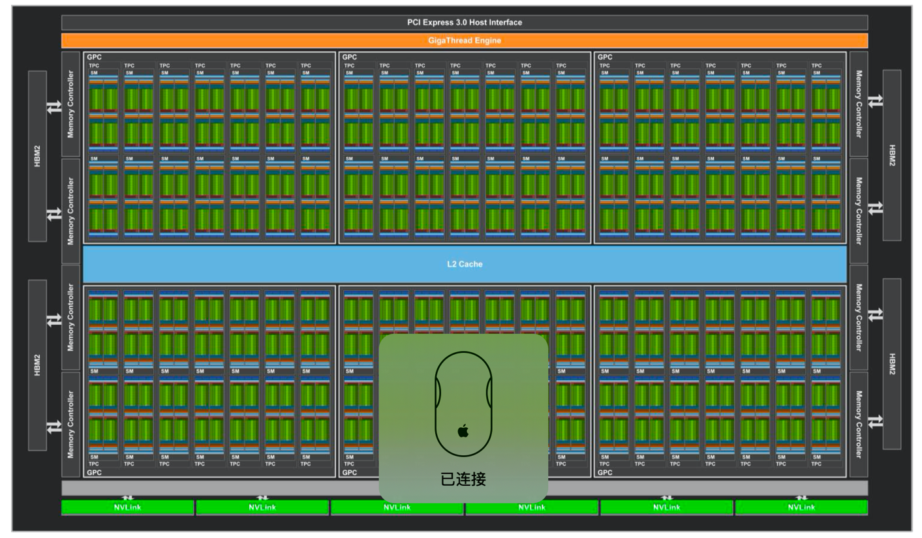
Volta 架构第一代 Tensor Core
SM 中包含：
4 个 Warp Scheduler
4 个 Dispatch Unit
64 个 FP32 Core
64 个 INT32 Core
32 个 FP64 Core
8 个 Tensor Core
32 个 LD/ST Unit
4 个 SFU

Slide 6
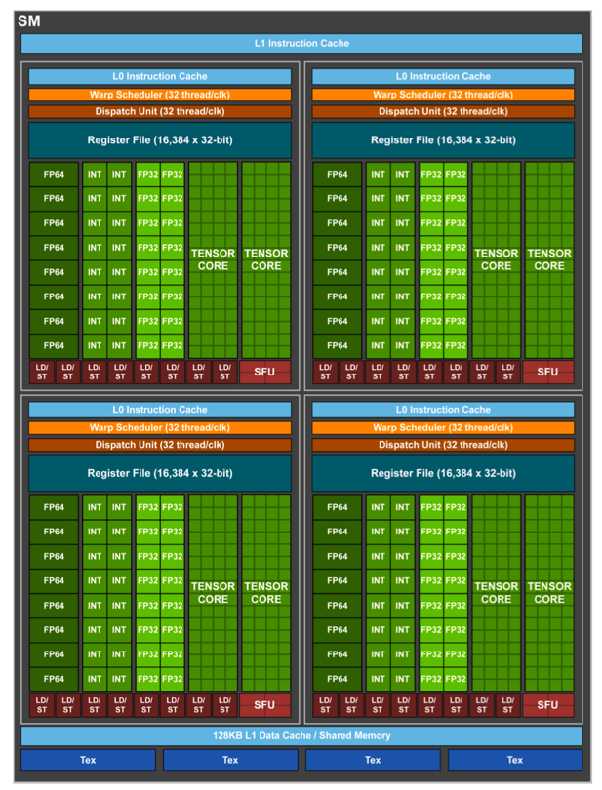
Volta 架构第一代 Tensor Core
SM 中包含：
4 个 Warp Scheduler，4 个 Dispatch Unit
64 个 FP32 Core（4 * 16）
64 个 INT32 Core（4 * 16）
32 个 FP64 Core（4 * 8）
8 个 Tensor Core （4 * 2）
32 个 LD/ST Unit（4 * 8）
4 个 SFU
FP32 和 INT32 两组运算单元独立出现在流水线中，每个 Cycle 都可以同时执行 FP32 和 INT32 指令。

Slide 7
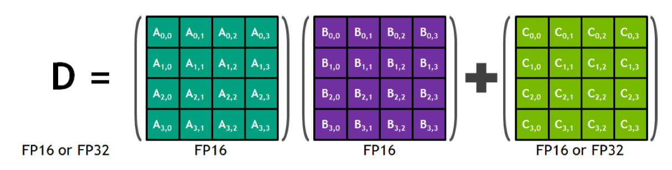
Volta 架构第一代 Tensor Core
GPU 并行模式实现深度学习功能过于通用，最常见 Conv/GEMM 操作，依旧要被编码成 FMA，硬件层面还是需要把数据按：寄存器-ALU-寄存器-ALU-寄存器 ，方式来回搬运。
每个 Tensor Core 每周期能执行 4x4x4 GEMM，即 64 个 FMA。虽然只支持 FP16 数据，但输出可以是 FP32，相当于 64 个 FP32 ALU 提供算力，能耗上还有优势。

Slide 8
Tensor Core: V100 vs A100

Slide 9
卷积计算
Convolutional neural networks contain many convolution layers that, when you examine the core operation, come down to many dot products. These operations can be batched together to run as a single, large, matrix multiplication operation.

Slide 10
Tesla V100’s Tensor Cores are programmable matrix-multiply-and-accumulate units that can deliver up to 125 Tensor TFLOPS for training and inference applications. The Tesla V100 GPU contains 640 Tensor Cores: 8 per SM. Tensor Cores and their associated data paths are custom-crafted to dramatically increase floating-point compute throughput at only modest area and power costs. Clock gating is used extensively to maximize power savings.
Each Tensor Core provides a 4x4x4 matrix processing array which performs the operation D = A * B + C, where A, B, C and D are 4×4 matrices as Figure 1 shows. The matrix multiply inputs A and B are FP16 matrices, while the accumulation matrices C and D may be FP16 or FP32 matrices.

Slide 12
Each Tensor Core performs 64 floating point FMA mixed-precision operations per clock (FP16 input multiply with full-precision product and FP32 accumulate, as Figure 2 shows) and 8 Tensor Cores in an SM perform a total of 1024 floating point operations per clock. This is a dramatic 8X increase in throughput for deep learning applications per SM compared to Pascal GP100 using standard FP32 operations, resulting in a total 12X increase in throughput for the Volta V100 GPU compared to the Pascal P100 GPU. Tensor Cores operate on FP16 input data with FP32 accumulation. The FP16 multiply results in a full-precision result that is accumulated in FP32 operations with the other products in a given dot product for a 4x4x4 matrix multiply, as Figure 8 shows.
During program execution, multiple Tensor Cores are used concurrently by a full warp of execution. The threads within a warp provide a larger 16x16x16 matrix operation to be processed by the Tensor Cores. CUDA exposes these operations as warp-level matrix operations in the CUDA C++ WMMA API. These C++ interfaces provide specialized matrix load, matrix multiply and accumulate, and matrix store operations to efficiently utilize Tensor Cores in CUDA C++ programs.

Slide 14
第一代 Tensor Core (Volta)
SM：Sub-Core 上计算单元对于寄存器的读写逻辑。Sub-Core 包括 Tensor Core + FP64 + FP32 + INT8 + 特殊函数处理单元 MUFU，计算单元都由 Warp Scheduler 调度执行，数据存储在寄存器。
Each SM sub-core also contains two 4x4x4 tensor cores. The Warp scheduler issues matrix multiply operations to the tensor cores for execution. The tensor cores receive input matrices from the register file, perform multiple 4x4x4 matrix multiplies until the full matrix multiply is completed, and write the resulting matrix back into the register file。

Slide 15
第一代 Tensor Core (Volta)

Slide 16
第二代 Tensor Core (Turing)
SM：Tensor Core 中增加对 Int8 和 Int4 类型支持，同时多了FP16 Fast path。
The Tensor Core is tightly integrated into the SM subcore. It performs a single multi-thread collaborative matrix math operation over four to eight clocks, which saves operand and memory bandwidth by transparently sharing data across threads.

Slide 17
第二代 Tensor Core (Turing)

Slide 18
第三代 Tensor Core (Ampere)

Slide 19
第三代 Tensor Core (Ampere)
Ampere之前的GPU架构中，如果要使用共享内存（shared memory, 偏硬件的文章中称scratch pad），必须先把数据从全局内存（global memory）加载到寄存器中，然后再写入共享内存。
这样就会浪费掉一部分寄存器资源同时增加了数据搬运的latency
Ampere架构中提供了异步内存拷贝机制，通过LDGSTS SASS指令（LoaD Global STore Shared）实现全局内存不经过寄存器直接到共享内存的数据加载。

Slide 20
第三代 Tensor Core (Ampere)

Slide 21
第三代 Tensor Core (Ampere)
The NVIDIA Ampere architecture third-generation Tensor Core allows data to be shared across all 32 threads in a warp, compared to 8 threads on Volta's Tensor Core. Sharing data across more threads reduces the register file bandwidth for feeding data to the Tensor Cores.”，“Overall, when computing matrix multiply operations A100 issues 8x fewer instructions and performs 2.9x fewer register file accesses than V100.
V100中Tensor Core可以聚合的操作八个线程的寄存器，A100则可以操作32个线程的所有寄存器。
A100's enhanced 16x8x16 Tensor Core (TC) instructions improve on V100 by reducing register accesses from 80 to 28, and hardware instructions issued from 16 to 2”

Slide 22
第四代 Tensor Core (Hopper)
前三代Tensor Core整体是在warp Level来编程的，即通过SIMT完成矩阵计算所需数据的准备工作，将数据从全局内存加载到寄存器上，而后通过Warp调度器调用Tensor Core完成矩阵乘法，继而将结果写出到SIMT的寄存器上
i. 数据搬运和计算耦合，i. scalability有限，详细地，我们在给Tensor Core准备数据的时候，需要warp内所有线程协调地考虑加载一部分矩阵数据，每一个线程都要算得自己独立的矩阵块的一部分地址，再加上为了隐藏数据加载的延时，全局内存到共享内存，共享内存到寄存器的数据加载都会构建多层级的软流水（software pipeline），消耗了很多寄存器及存储带宽；可扩展性方面，由于存储空间的限制，单个warp的矩阵计算规格是有上限的。

Slide 23
第四代 Tensor Core (Hopper)
引入TMA单元（Tensor Memory Accelerator）:将异步数据加载能力固化在硬件中，Ampere中首次提供了异步数据加载能力，即全局内存中的数据可以被异步地加载到共享内存，但在Ampere中所有的地址计算尤其是为了克服共享内存的bank conflict而设计出的异或交叉排列方法也需由各个线程完成，在hopper中，直接以独立硬件单元的形式提供了全局内存和共享内存之间双向的异步读写能力，该能力采用单线程schedule模型，不需要所有线程都参与，同时使用TMA之前只需要一次性的配置好首地址、偏移量、等Tensor描述信息即可；

Slide 24
第四代 Tensor Core (Hopper)
引入分布式共享内存和warpgroup编程模式：在hopper之前的编程模式中，只有block和grid两个层次，其分别对应硬件上的SM和Device，当SM数量不断增加时，数据局部性只能限制在SM内部（通过shared memory），不能跨越SM边界，hopper架构中在GPC内部通过引入交叉互连网络以及同步元语将数据共享层次扩展到4个SMs，也就是GPC内的SM间可以高效的访问彼此的共享内存，这种结构很好的提升了数据的复用性，为了能编程使用该结构，cuda编程语言中也对应的引入了Thread Block Cluster的概念

Slide 25
第四代 Tensor Core (Hopper)
引入可以直接读取共享内存的异步Tensor Core：TMA可以高效简单的完成Tensor数据在全局内存和共享内存之间的流转，分布式共享内存和Barrier将SM组织成一个更大的计算和存储单元，能从共享内存直接加载数据的、异步的Tensor Core在这种背景下也就显得很自然了，它突破了之前架构 Tensor Core只能工作在warp level的限制, hopper架构的Tensor Core可以工作在warpgroup上（通过IGMMA，HGMMA，QGMMA等SASS指令实现），其可以直接读取共享内存，对于其计算输出而言，仍然为寄存器，一方面其可以很好的利用寄存器的高带宽，另一方面GEMM/CONV后一般会做一些激活、normalize等后处理。由于读取共享内存有不稳定的latency，所以提供异步能力就也成了其必然的选择。这样通过TMA完成数据从global到shared memory的异步加载，Tensor Core完成异步加载shared memory数据到寄存器的计算，通过硬件实现了矩阵乘法的流水线。

Slide 26
Padding Vocabulary Size – Projection Layer Example
Figure 1 shows a simplified representation of a Transformer network. The network outputs a vector containing a probability for each token in the vocabulary. This vector of probabilities is produced using the softmax function over the outputs from a fully-connected layer, which we’ll call the projection layer. The number of outputs of this layer is equal to the vocabulary size, often in excess of 30,000. Given the heavyweight computation involved, it’s important to ensure effective Tensor Core use.
Figure 2 shows the performance of one such projection layer, with 1024 inputs and a batch size of 5120, training on FP16 data on a Volta Tesla V100. Suppose we are using the combined English-German training datasets for the WMT14 task, which have a vocabulary size of 33708. Simply padding the vocabulary size to the next multiple of 8 activates Tensor Cores and improves throughput significantly

Slide 27
Padding Vocabulary Size – Projection Layer Example

Slide 28
Summary 总结

Slide 29
Reference 引用&参考
https://zhuanlan.zhihu.com/p/620257581 大佬们，A100显卡上的tensorcore有自己的私有寄存器
https://old.hotchips.org/wp-content/uploads/hc_archives/hc29/HC29.21-Monday-Pub/HC29.21.10-GPU-Gaming-Pub/HC29.21.132-Volta-Choquette-NVIDIA-Final3.pdf
https://ieeexplore.ieee.org/author/37086370271
https://www.computer.org/csdl/proceedings-article/hcs/2019/08875651/1ehCtCN4SUE
https://resources.nvidia.com/en-us-genomics-ep/ampere-architecture-white-paper
https://developer.nvidia.com/blog/nvidia-hopper-architecture-in-depth/

Slide 30
Notes:
30

